Slide 1

Entrepreneurship: Successfully Launching New Ventures
Sixth Edition
Chapter 5
Industry and Competitor Analysis
Notes:
If this PowerPoint presentation contains mathematical equations, you may need to check that your computer has the following installed:
1) MathType Plugin
2) Math Player (free versions available)
3) NVDA Reader (free versions available)

Slide 2
Learning Objectives
5.1 Explain the purpose of an industry analysis.
5.2 Identify and discuss the five competitive forces that determine industry profitability.
5.3 Explain the value that entrepreneurial firms create by successfully using the five forces model.
5.4 Identify the five primary industry types and the opportunities they offer.
5.5 Explain the purpose of a competitor analysis and a competitive analysis grid.

Slide 3
What is Industry Analysis?
Industry
An industry is a group of firms producing a similar product or service, such as music, Pilates and Yoga studios, and solar panels.
Industry Analysis
Is business research that focuses on the potential of an industry.

Slide 4
Why Is Industry Analysis Important?
Industry Analysis
Importance
Once it is determined that a new venture is feasible in regard to the industry and market in which it will compete, a more in-depth analysis is needed to learn the ins and outs of the industry.
The analysis helps a firm determine if the target market it identified during feasibility analysis is favorable for a new firm.

Slide 5
Three Key Questions
When studying an industry, an entrepreneur must answer three questions before pursuing the idea of starting a firm.
Question 1
Is the industry accessible—in other words, is it a realistic place for a new venture to enter?
Question 2
Does the industry contain markets that are ripe for innovation or are underserved?
Question 3
Are there positions in the industry that will avoid some of the negative attributes of the industry as a whole?

Slide 6
Techniques Available to Assess Industry Attractiveness
Assessing Industry Attractiveness
Study Environmental and Business Trends
The Five Competitive Forces Model

Slide 7
Studying Industry Trends (1 of 3)
The first technique an entrepreneur has available to discern the attractiveness of an industry is to study industry trends.
There are two types of trends:
Environmental trends
Business trends

Slide 8
Studying Industry Trends (2 of 3)
Environmental Trends
The strength of an industry often surges or wanes because environmental trends shift in favor or against the industry.
Environmental trends include economic trends, social trends, technological advances, and political and regulatory changes.
For example, companies in industries selling products to seniors, such as the hearing aid industry, benefit from the social trend of the aging of the population.

Slide 9
Studying Industry Trends (3 of 3)
Business Trends
Other trends affect industries that aren’t environmental trends per se but are part of the core nature of an industry.
For example, the firms in some industries benefit from an increasing ability to outsource manufacturing or service functions to lower-cost foreign labor markets, while firms in other industries don’t share this advantage.

Slide 10
The Five Competitive Forces Model (1 of 3)
Explanation of the Five Forces Model
The five competitive forces model is a framework for understanding the structure of an industry.
The model is composed of the forces that determine industry profitability.
They help determine the average rate of return for the firms in an industry.

Slide 11
The Five Competitive Forces Model (2 of 3)
Explanation of the Five Forces Model (continued)
Each of the five forces impacts the average rate of return for the firms in an industry by applying pressure on industry profitability.
Well-managed firms try to position their firms in a way that avoids or diminishes these forces—in an attempt to beat the average rate of return of the industry.

Slide 12
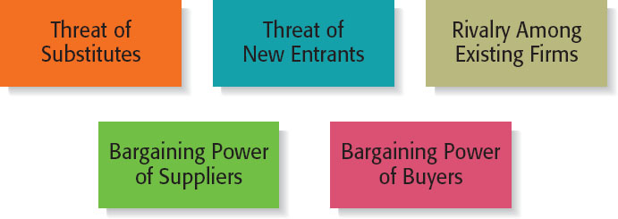
The Five Competitive Forces Model (3 of 3)
Figure 5.1 Forces That Determine Industry Profitability

Slide 13
Threat of Substitutes (1 of 2)
Threat of Substitutes
The price that consumers are willing to pay for a product depends in part on the availability of substitute products.
For example, there are few, if any, substitutes for prescription medicines, which is one of the reasons the pharmaceutical industry is so profitable.
In contrast, when close substitutes for a product exist, industry profitability is suppressed, because consumers will opt out if the price gets too high.

Slide 14
Threat of Substitutes (2 of 2)
Threat of Substitutes (continued)
The extent to which substitutes suppress the profitability of an industry depends on the propensity for buyers to substitute between alternatives.
This is why firms in an industry often offer their customers amenities to reduce the likelihood that they will switch to a substitute product, even in light of a price increase.

Slide 15
Threat of New Entrants (1 of 6)
Threat of New Entrants
If the firms in an industry are highly profitable, the industry becomes a magnet to new entrants.
Unless something is done to stop this, the competition in the industry will increase, and average industry profitability will decline.
Firms in an industry try to keep the number of new entrants low by erecting barriers to entry.
A barrier to entry is a condition that creates a disincentive for a new firm to enter an industry.

Slide 16
Threat of New Entrants (2 of 6)
Barriers to Entry
Barrier to Entry | Explanation
Economies of Scale | Industries that are characterized by large economies of scale are difficult for new firms to enter, unless they are willing to accept a cost disadvantage.
Product differentiation | Industries such as the soft drink industry that are characterized by firms with strong brands are difficult to break into without spending heavily on advertising.
Capital requirements | The need to invest large amounts of money to gain entrance to an industry is another barrier to entry.

Slide 17
Threat of New Entrants (3 of 6)
Barriers to Entry (continued)
Barrier to Entry | Explanation
Cost advantages independent of size | Existing firms may have cost advantages not related to size. For example, the existing firms in an industry may have purchased land when it was less expensive than it is today.
Access to distribution channels | Distribution channels are often hard to crack. This is particularly true in crowded markets, such as the convenience store market.
Government and legal barriers | Some industries, such as banking and broadcasting, require the granting of a license by a public authority to compete.

Slide 18
Threat of New Entrants (4 of 6)
Nontraditional Barriers to Entry
It is difficult for start-ups to execute barriers to entry that are expensive, such as economies of scale, because money is usually tight.
Start-ups have to rely on nontraditional barriers to entry to discourage new entrants, such as assembling a world-class management team that would be difficult for another company to replicate.

Slide 19
Threat of New Entrants (5 of 6)
Nontraditional Barriers to Entry
Barrier to Entry | Explanation
Strength of management team | If a start-up puts together a world-class management team, it may give potential rivals pause in taking on the start-up in its chosen industry.
First-mover advantage | If a start-up pioneers an industry or a new concept within an industry, the name recognition the start-up establishes may create a barrier to entry.
Passion of the management team and employees | If the employees of a start-up are motivated by the unique culture of a start-up, and anticipate a large financial reward, this is a combination that cannot be replicated by larger firms.

Slide 20
Threat of New Entrants (6 of 6)
Nontraditional Barriers to Entry (continued)
Barrier to Entry | Explanation
Unique business model | If a start-up is able to construct a unique business model and establish a network of relationships that makes the business model work, this set of advantages creates a barrier to entry.
Internet domain name | Some Internet domain names are so “spot-on” that they give a start-up a meaningful leg up in terms of e-commerce opportunities.
Inventing a new approach to an industry | If a start-up invents a new approach to an industry and executes it in an exemplary fashion, these factors create a barrier to entry for potential imitators.

Slide 21
Rivalry Among Existing Firms (1 of 3)
Rivalry Among Existing Firms
In most industries, the major determinant of industry profitability is the level of competition among existing firms.
Some industries are fiercely competitive, to the point where prices are pushed below the level of costs, and industry-wide losses occur.
In other industries, competition is much less intense and price competition is subdued.

Slide 22
Rivalry Among Existing Firms (2 of 3)
Factors that determine the intensity of the rivalry among existing firms in an industry
Number and balance of competitors | The more competitors there are, the more likely it is that one or more will try to gain customers by cutting its price.
Degree of difference between products | The degree to which products differ from one producer to another affects industry rivalry.

Slide 23
Rivalry Among Existing Firms (3 of 3)
Factors that determine the intensity of the rivalry among existing firms in an industry (continued)
Growth rate of an industry | The competition among firms in a slow-growth industry is stronger than among those in fast-growth industries.
Level of fixed costs | Firms that have high fixed costs must sell a higher volume of their product to reach the break-even point than firms with low fixed costs.

Slide 24
Bargaining Power of Suppliers (1 of 3)
Bargaining Power of Suppliers
Suppliers can suppress the profitability of the industries to which they sell by raising prices or reducing the quality of the components they provide.
If a supplier reduces the quality of the components it supplies, the quality of the finished product will suffer, and the manufacturer will eventually have to lower its price.
If the suppliers are powerful relative to the firms in the industry to which they sell, industry profitability can suffer.

Slide 25
Bargaining Power of Suppliers (2 of 3)
Factors that have an impact on the ability of suppliers to exert pressure on buyers
Supplier concentration | When there are only a few suppliers that supply a critical product to a large number of buyers, the supplier has an advantage.
Switching costs | Switching costs are the fixed costs that buyers encounter when switching or changing from one supplier to another. If switching costs are high, a buyer will be less likely to switch suppliers.

Slide 26
Bargaining Power of Suppliers (3 of 3)
Factors that have an impact on the ability of suppliers to exert pressure on buyers (continued)
Attractiveness of substitutes | Supplier power is enhanced if there are no attractive substitutes for the products or services the supplier offers.
Threat of forward integration | The power of a supplier is enhanced if there is a credible possibility that the supplier might enter the buyer’s industry.

Slide 27
Bargaining Power of Buyers (1 of 3)
Bargaining Power of Buyers
Buyers can suppress the profitability of the industries from which they purchase by demanding price concessions or increases in quality.
For example, the automobile industry is dominated by a handful of large companies that buy products from thousands of suppliers in different industries. This allows the automakers to suppress the profitability of the industries from which they buy by demanding price reductions.

Slide 28
Bargaining Power of Buyers (2 of 3)
Factors that have an impact on the ability of buyers to exert pressure on suppliers
Buyer group concentration | If there are only a few large buyers, and they buy from a large number of suppliers, they can pressure the suppliers to lower costs and thus affect the profitability of the industries from which they buy.
Buyer’s costs | The greater the importance of an item is to a buyer, the more sensitive the buyer will be to the price it pays.

Slide 29
Bargaining Power of Buyers (3 of 3)
Factors that have an impact on the ability of buyers to exert pressure on suppliers (continued)
Degree of standardization of supplier’s products | The degree to which a supplier’s product differs from its competitors affects the buyer’s bargaining power.
Threat of backward integration | The power of buyers is enhanced if there is a credible threat that the buyer might enter the supplier’s industry.

Slide 30
First Application of the Five Forces Model (1 of 2)
First Application of the Model
The five forces model can be used to assess the attractiveness of an industry by determining the level of threat to industry profitability for each of the forces.
If a firm fills out the form shown on the next slide and several of the threats to industry profitability are high, the firm may want to reconsider entering the industry or think carefully about the position it would occupy.

Slide 31
First Application of the Five Forces Model (2 of 2)
Assessing Industry Attractiveness Using the Five Forces Model
Competitive Force | Threat to Industry Profitability Low | Threat to Industry Profitability Medium | Threat to Industry Profitability High
Threat of substitutes | blank | blank | blank
Threat of new entrants | blank | blank | blank
Rivalry among existing firms | blank | blank | blank
Bargaining power of suppliers | blank | blank | blank
Bargaining power of buyers | blank | blank | blank
Instructions:
Step 1: Select in industry.
Step 2: Determine the level of threat to industry profitability for each of the forces (low, medium or high).
Step 3: Use the table to develop an overall feel for the attractiveness of the industry.
Step 4: Use the table to identify the threats that are most often relevant to industry profitability.

Slide 32
Second Application of the Five Forces Model (1 of 2)
Second Application of the Model
The second way a new firm can apply the five forces model to help determine whether it should enter an industry is by using the model to answer several key questions.
The questions are shown in the figure on the next slide, and help a firm project the potential success of a new venture in a particular industry.

Slide 33
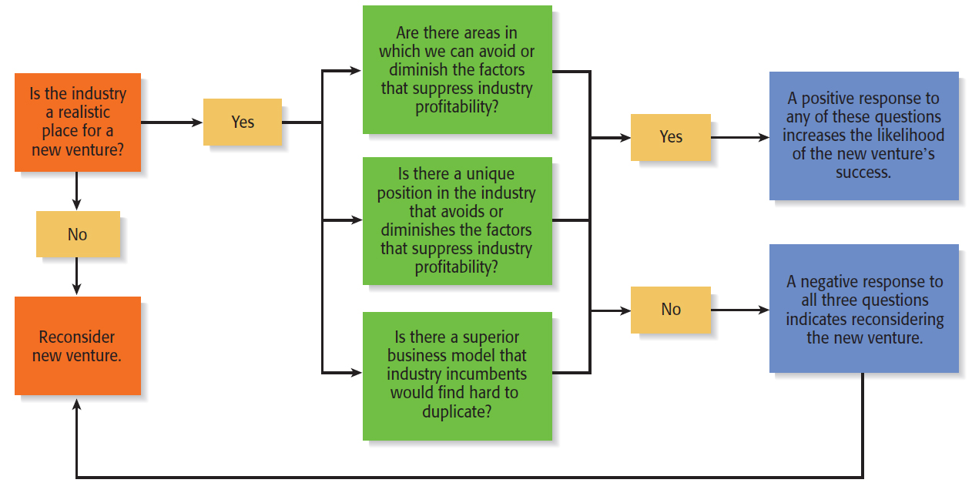
Second Application of the Five Forces Model (2 of 2)
Using the Five Forces Model to Pose Questions to Determine the Potential Success of a New Venture in an Industry

Slide 34
Industry Types and the Opportunities They Offer (1 of 3)
Emerging Industries
Industries in which standard operating procedures have yet to be developed.
Opportunity: First-mover advantage.
Fragmented Industries
Industries that are characterized by a large number of firms of approximately equal size.
Opportunity: Consolidation.

Slide 35
Industry Types and the Opportunities They Offer (2 of 3)
Mature Industries
Industries that are experiencing slow or no increase in demand.
Opportunities: Process innovation and after-sale service innovation.
Declining Industries
Industries that are experiencing a reduction in demand.
Opportunities: Leadership, establishing a niche market, and pursuing a cost reduction strategy.

Slide 36
Industry Types and the Opportunities They Offer (3 of 3)
Global Industries
Industries that are experiencing significant international sales.
Opportunities: Multidomestic and global strategies.

Slide 37
Competitor Analysis
What is a Competitor Analysis?
A competitor analysis is a detailed analysis of a firm’s competition.
It helps a firm understand the positions of its major competitors and the opportunities that are available.
A competitive analysis grid is a tool for organizing the information a firm collects about its competitors.

Slide 38
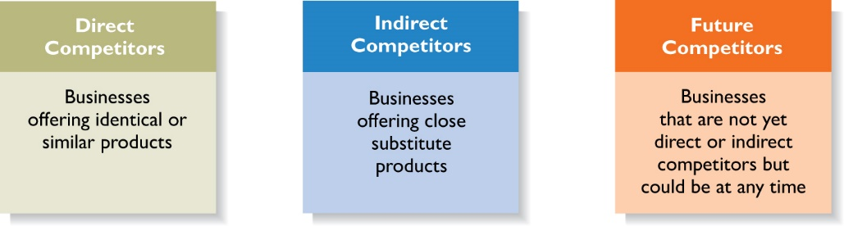
Identifying Competitors
Types of Competitors New Ventures Face

Slide 39
Sources of Competitive Intelligence (1 of 2)
Collecting Competitive Intelligence
To complete a competitive analysis grid, a firm must first understand the strategies and behaviors of its competitors.
The information that is gathered by a firm to learn about its competitors is referred to as competitive intelligence.
A new venture should take care that it collects competitive intelligence in a professional and ethical manner.

Slide 40
Sources of Competitive Intelligence (2 of 2)
Ethical ways to obtain information about competitors
Attend conferences and trade shows.
Purchase competitors’ products.
Study competitors’ Web sites and social media sites.
Set up Google e-mail alerts.
Read industry-related books, magazines, and Web sites.
Talk to customers about what motivated them to buy your product as opposed to your competitor’s product.

Slide 41
Completing a Competitive Analysis Grid
Competitive Analysis Grid
A tool for organizing the information a firm collects about its competitors.
A competitive analysis grid can help a firm see how it stacks up against its competitors, provide ideas for markets to pursue, and identify its primary sources of competitive advantage.

Slide 42
Competitive Analysis Grid for Panera Bread
Table 5.5 Competitive Analysis Grid for Panera Bread
Name | Panera Bread | McAlister’s Deli | Chipotle Mexican Grill | Panda Express | Qdoba
Price | Even | Even | Even | Advantage | Even
Selection | Even | Even | Disadvantage | Disadvantage | Disadvantage
Perception of providing good, wholesome food | Advantage | Even | Even | Disadvantage | Even
Dining environment | Advantage | Even | Even | Disadvantage | Disadvantage
Speed of service | Even | Even | Advantage | Advantage | Advantage
Availability of Gluten free, non- GMO, organic, etc. | Even | Even | Even | Disadvantage | Even
Social Consciousness/ Philanthropy | Advantage | Even | Advantage | Even | Even

Slide 43

Copyright

